Slide 1
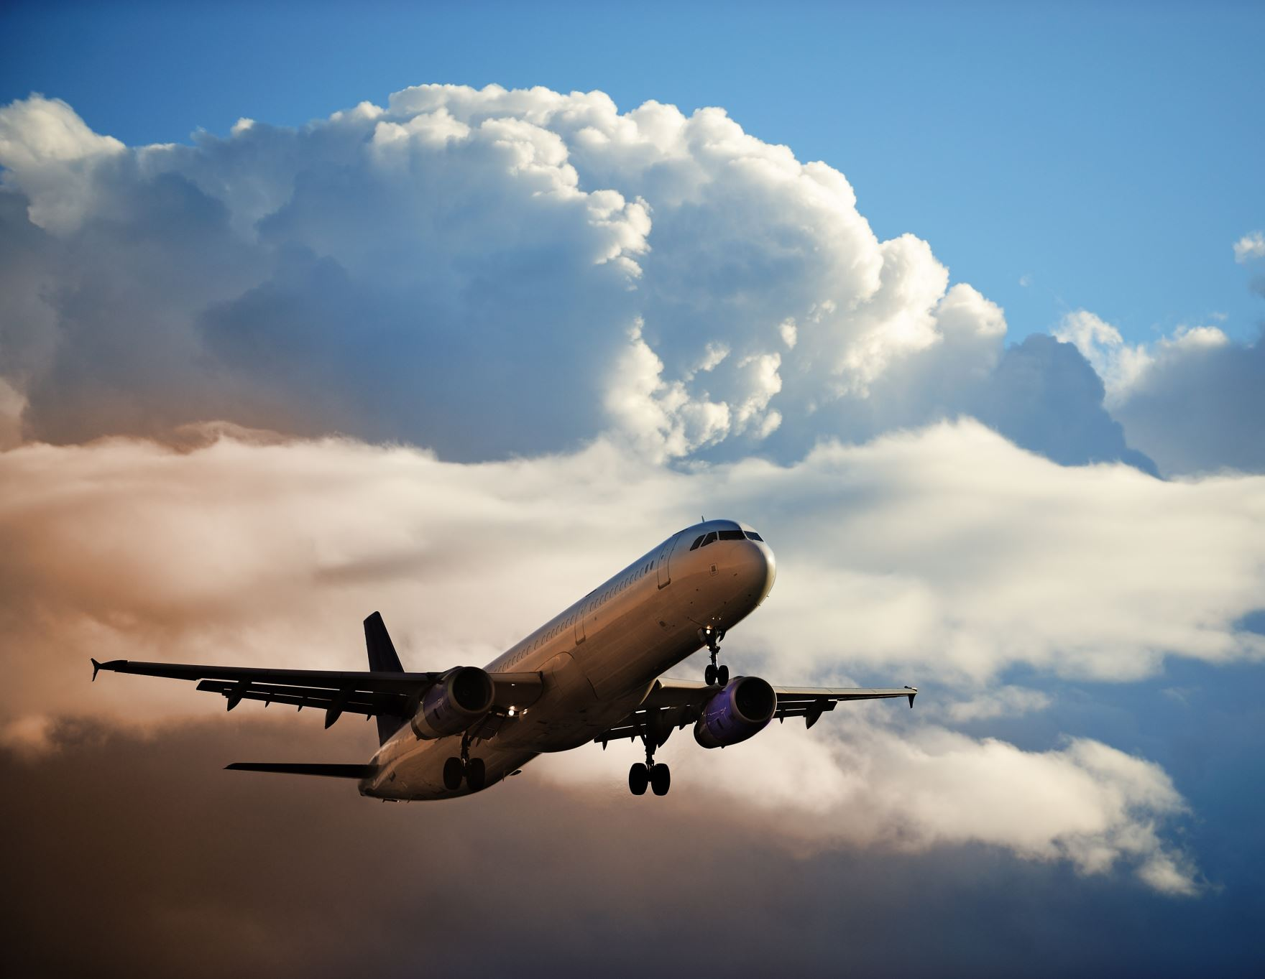
Plane Crash Analysis
Presenter: Shao Ming

Slide 2
Content Page
Introduce Dataset and its features
Data Cleaning & Feature Engineering
Data Visualisation and inference
Future Recommendation

Slide 3
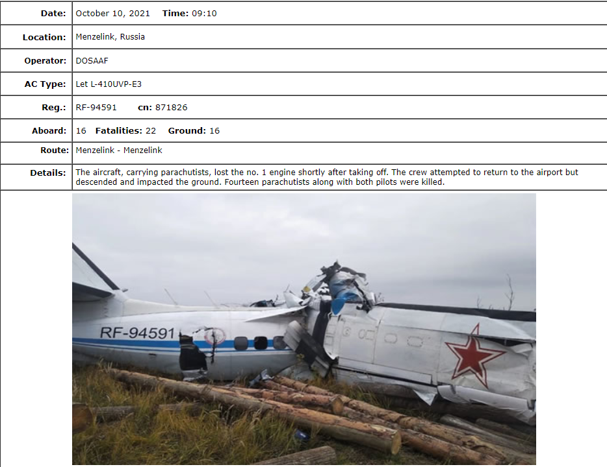
Context
The aviation accident database throughout the world, from 1908-2019.
Data scraped from http://www.planecrashinfo.com/database.htm
Features:
Date and time
Location of crash
Operator
Aircraft Type
Registration (Reg.), serial number (cn), Flight number
Total aboard, fatalities aboard, killed on ground

Slide 4
Motivation:
Business Question:
What is the root cause of the plane crash?
Data Science Questions?

Slide 5
Data Science questions
Feature | Questions
Date | Trend of Accident
Time | Does accident usually occurs on Day or night
Location | Where does accident likely to occur?
Operator | Who is the worst operator?
Aircraft Type | Which aircraft type is the worst?
Reg. & cn numbers, Flight number | -
Route | Which route is the most dangerous?
Total aboard, fatalities aboard | Is it possible to survive a plane crash?
Killed on ground | -
Summary | NLP analysis

Slide 6
Data Cleaning
Feature | % of null values
Date | 0
Time | 42%
Location | 0.38%
Operator | 0.34%
Aircraft Type | 0.51%
Reg. & cn numbers & Flight number | 6.36% & 23.3% & 79.7%
Route | 32.38%
Total aboard, fatalities aboard | 0.418%, 0.228%
Killed on ground | 0.418%
Summary | 7.4%

Slide 7
Feature Engineering
Date
1984-07-12
Year
1984
Month
07
Day name
Thursday
Operator
Military - U.S. Air Force
American Airlines
IsMilitary?
True
False
Location
San Francisco, California
geopy.geocoders
Latitude
37.779026
Longitude
-122.419906

Slide 8

Data Visualization

Slide 9
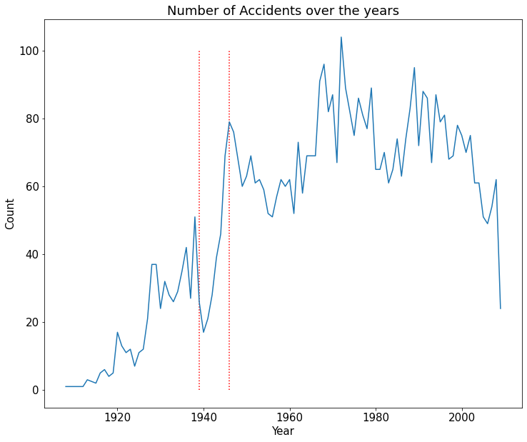
The number of accidents generally increase with the demand in transport on air.
After year 2000, it gradually drop…
During WWII (1939 to 1945), sharp increase!

Slide 10
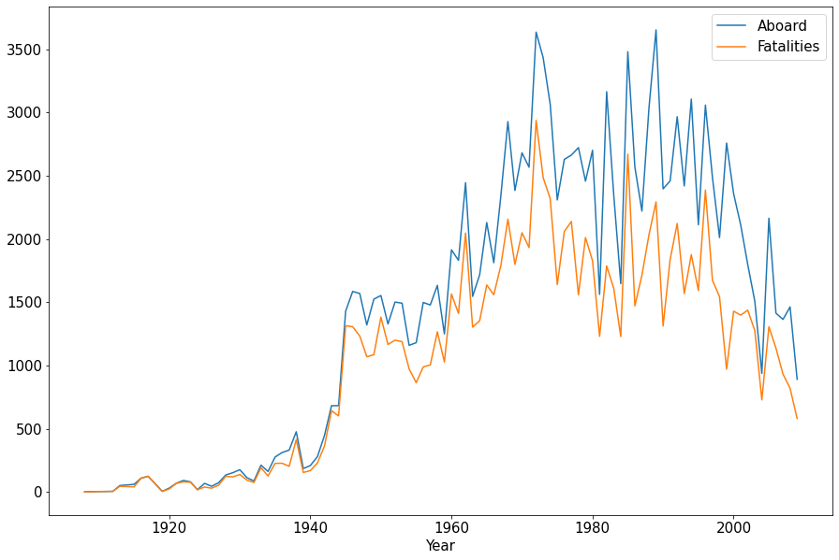
Observation:
Fatalities rate has improved over the years
Inference:
Operators are better at dealing with emergency landing.

Slide 11
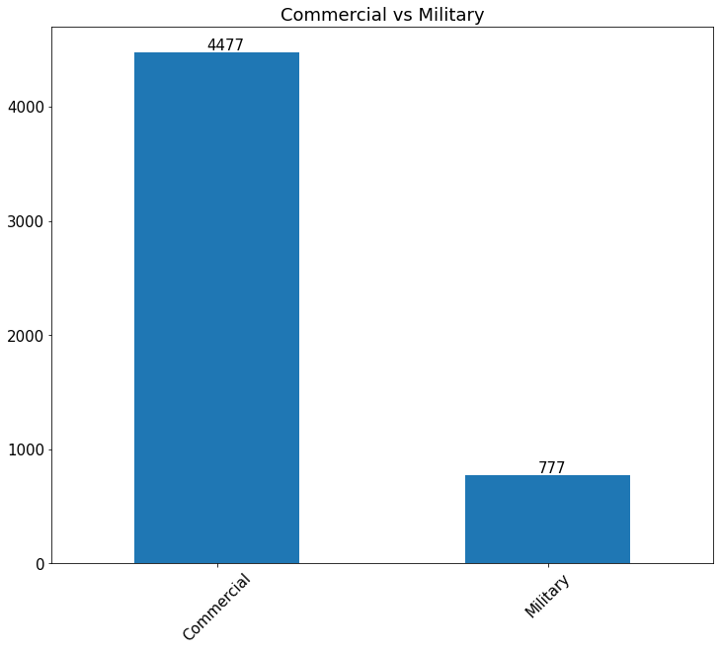
Feature used: IsMilitary?
Observation:
85% of the accidents belong to Commercial Planes
Inference:
Military operators are better trained at driving
Solution:
More attentions to be paid on Commercial planes

Slide 12
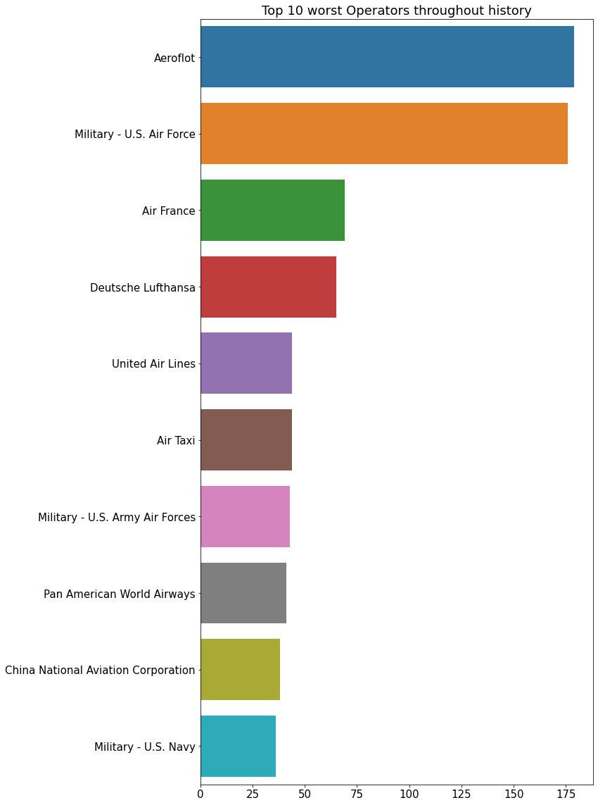
Worst Operators
Aeroflot:
Russian Airlines, founded in 1923
U.S. Air Force

Slide 13
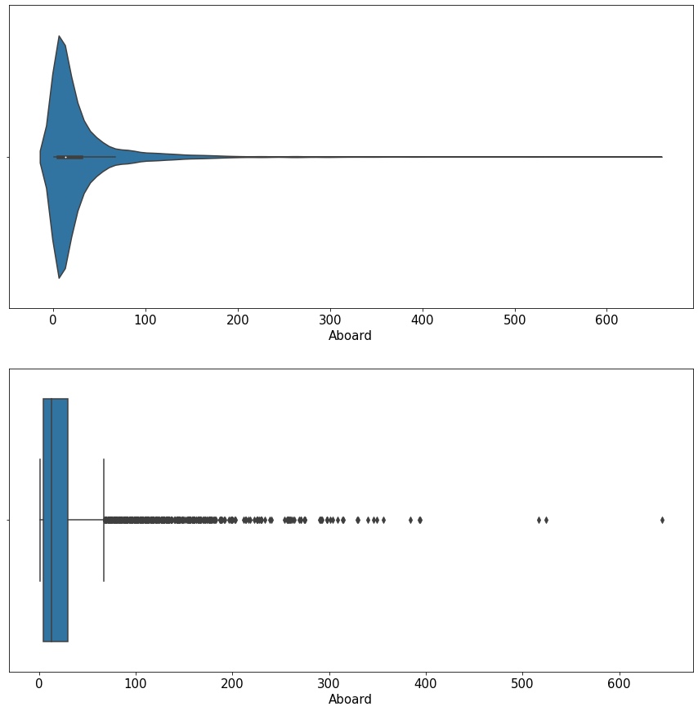
Inference:
Pilots tend to operate the plane more carefully when dealing with large number of passengers
OR
Most of the accidents happen during Test Flight

Slide 14
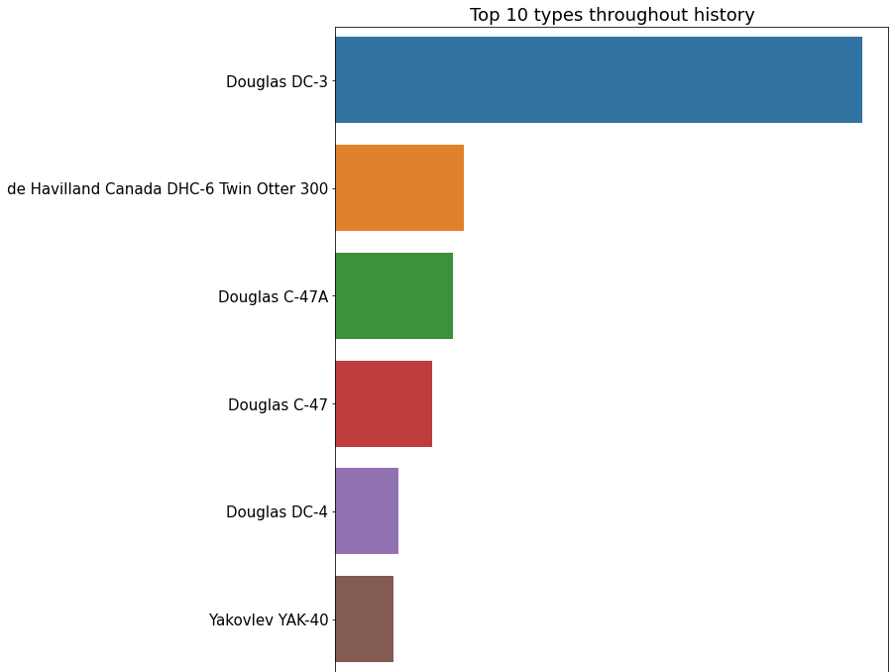
The number accidents caused by Douglas DC-3 is off the chart!
DC-3 is the world’s first successful commercial airliner, readily adapted to military use during World War II.
Most of the accident happen during WWII?

Slide 15
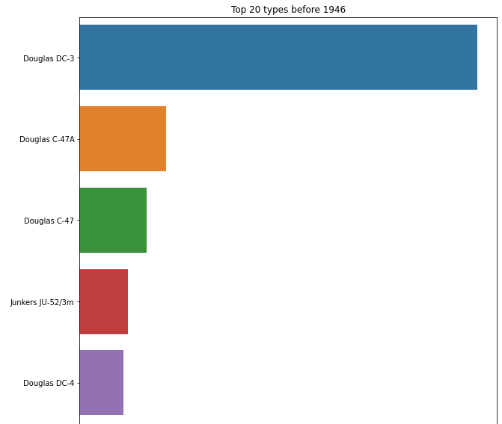
Before WWII

Slide 16
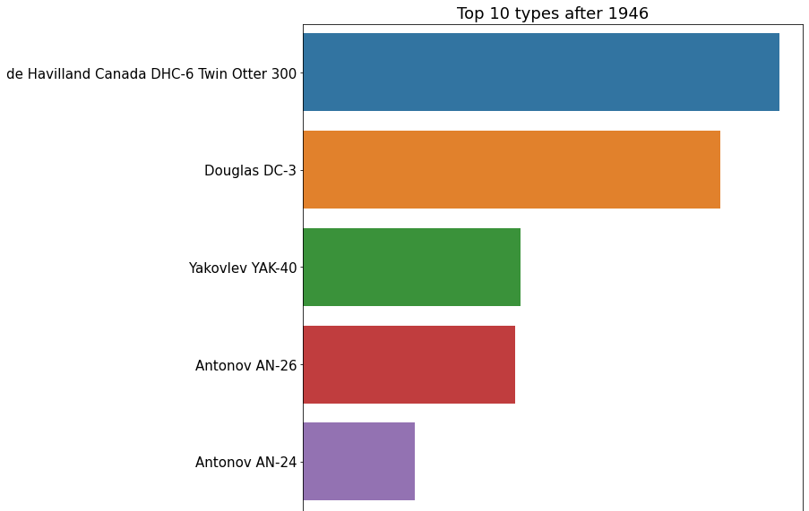
After WWII

Slide 17
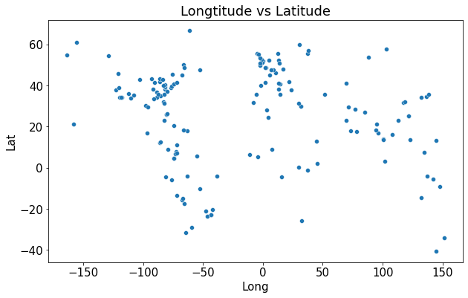
Clustering Problem!!!
We can find out which region is more likely to have accidents!

Slide 18
Future work
Unsupervised learning: K-means Clustering
Air types with 2443 unique names can be further categories into main groups
Analysis on repeated words on Summary (NLP)

Slide 19
Summary
Most of crashes come from Commercial Airline
Planes with lesser passengers more likely to crash
pilots can better deal with emergency landing
US Air Force and Aeroflot are the worst operators
All aircraft types (except DHC-6 & DC-3) does not relate to any accidents (?)

Slide 20

Questions?

